Slide 1
OPAGxCAMARA
Topics and Functionality prioritisation
Alex Harmand, Telefonica & OPAG Chair
14 April 2022

Slide 2
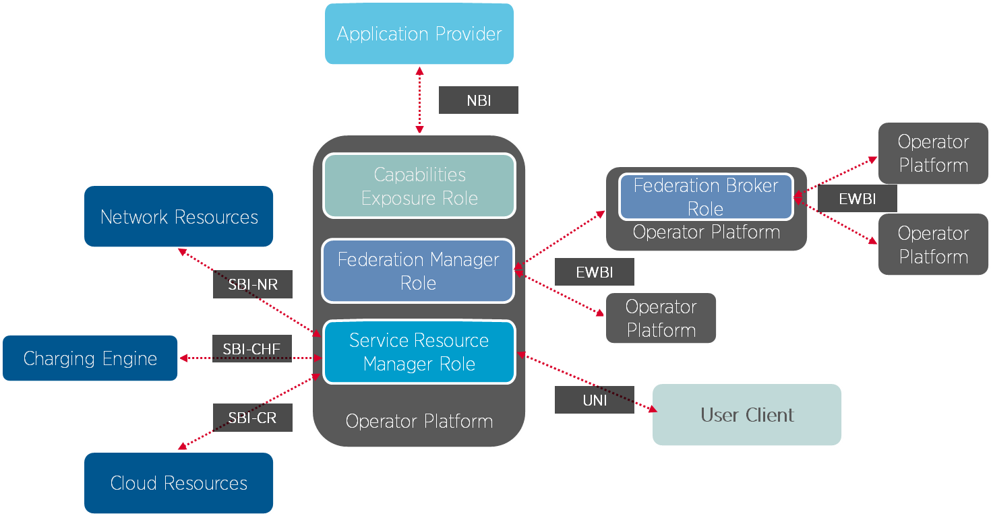
Reminder: Operator Platform - architecture
Other interfaces needed as well, e.g.
edge resources ⬄application
Cloudlet ⬄ Cloudlet
Device Application ⬄ UE/UNI
Not all covered in depth given focus on OP
Note: SBI-CR defined as flexible to fit in with orchestration and hyperscaler solutions used in different networks
Term | Description
CHF | Charging Function
CR | Cloud Resources
EWBI | East/Westbound Interface
NBI | Northbound Interface
NR | Network Resources
SBI | Southbound Interface
UNI | User Network Interface

Slide 3

Value of OP for edge computing and other capabilities The OP makes them a true interoperable operator service
Single entry point to subscribers serviced by all federated OPs
Similar to business voice call do not require connection to each MNO to reach user base
Requires alignment in service offered, e.g. similar compute profiles offered
Service in roaming and while mobile
Edge requires use of nearby compute resources that follow user when moving
Requires the integration with the (packet) core network provided by the OP
Can link of capabilities of different operators
Edge applications serving subscribers on different networks may have to interact
i.e. extends geographic and user base that is offered by MNO/OP provider
Similar to voice calls reaching subscribers wherever they are and while on the move
Similar to voice calls between subscribers on different operators
e.g. gaming against each other or automotive applications cooperating to improve accuracy
Ideally with smooth handover between networks cross-border
Disconnects service offering from capabilities
Similar to voice call service relying on multiple network capabilities
Developers may need an offering combining different capabilities
e.g. Edge with NaaS and/or slicing
OP providing access to all capabilities allows to break silos and merge capabilities into a single offering

Slide 4
OP offers clear differentials
Key platform differentials are in federation, network integration and northbound exposure capabilities
Priority in ensuring interface definition for these concepts
CAMARA
Key platform differentials

Slide 5
CAMARA relevance for OPAG
OPAG is in charge of defining the interfaces required by the Operator Platform concept. Northbound capability is one of the main differentiator where service APIs shall be built to foster platform adoption and usage by customers or developer community.
Collaboration with CAMARA is by OPAG as the way for service APIs and northbound definition and ensure that GSMA priorities and demand can be met.
A review of GSMA priorities should be done. A first northbound API package shall be tackled as a blue print in order to validate way of working and process between CAMARA and the GSMA

Slide 6
Against a life cycle towards service API development
OPG
(roadmap and requirements)
Interoperability Testing and conformance
(Interop validation in scope but will be agreed at later date)
Open Source dev and doc with LF
(maintenance of code, reference implementation, API verification)
OP API Group (OPAG)
(aligning contribution to Telco APIs project)
NOTE: API Subgroup and CAMARA Development output is to deliver a harmonized set of APIS for interfaces and where appropriate functional blocks, and NOT a full platform.
To support standardisation efforts, SDOs will receive two drops:-
Requirements after publishing
update based on additional requirements and/or documentation on APIs from implementation
Interop testing may cover standards when available.
SDOs
Legend AA.35 ACTIVITY | CAMARA project HOST TBCOST TBC

Slide 7
OP NBI: APIs
OPAG identified following APIs as part of the OP’s Northbound Interface:
API | Description
Application onboarding and image management | Provide and manage application images to be deployed on resources within the operator network
Application Instance Management (Resource Life-Cycle Management) | use reserved compute resources within the operator network for the deployment of applications on VMs or Containers
Telemetry | Track usage and load of resources/capabilities used within the operator network
Notifications | Be informed about events related to reserved/used resources/capabilities
Network Events | Be informed about events related to users/subscribers using the reserved/used resources/capabilities
Trouble Ticketing | Inform network(s) of issues arising around resource/capability reservation/usage
Application Resource Catalogue | Retrieve information on available resources and capabilities
Ordering | Reserve the use of resources/capabilities
Charging | Access charging capabilities of the network
Billing | Retrieve bill/billing data
QoS Management | Control QoS profiles used for user/subscriber access to application
Traffic Influence | Influence routing and mobility policies for traffic associated to application
Managing Service availability in LADN | Manage area where application should be available
Application relocation | Manage the relocation of a user session to another resource
Confirm User Location | Confirm whether the user is at a given location

Slide 8
Background: Prioritisation
OPAG prioritised the APIs to propose to CAMARA resulting in the following:
Priority | Topic
1 | Application onboarding and image management
2 | Application Instance Management (Resource Life-Cycle Management)
3 | QoS Management
4 | Telemetry
5 | Traffic Influence
6 | Network Events
7 | Confirm User Location
8 | Notifications
9 | Application Resource Catalogue
10 | Charging
11 | Application relocation
12 | Billing
13 | Trouble Ticketing
14 | Ordering
15 | Managing Service availability in LADN

Slide 9
Process
Collaboration process to be built. To be covered in commonalities?
OPAG will highlight the system/ network API mapping to be considered.
Process for service API to network API definition?
Priority APIs for GSMA handling?

Slide 10
Proposal
Based on priorities, OPAG will look into proposing APIs for edge applications to CAMARA
Image and application instance lifecycle management
Used as blue print to kick things of
Will be taken up once activities on defining APIs for federation have completed
Current timeline estimation: from May onwards
Proposal to start an edge work stream to handle such contributions and align them
Build process on the findings made from the exercise
Further topics would then follow later

